Slide 1
Congruent Triangles
Geometry
Chapter 5
Notes:
Geometry 5

Slide 2
This Slideshow was developed to accompany the textbook
  Big Ideas Geometry
  By Larson and Boswell
  2022 K12 (National Geographic/Cengage)
Some examples and diagrams are taken from the textbook.
Slides created by
Richard Wright, Andrews Academy
rwright@andrews.edu

Slide 3
5.1 Angles of Triangles
After this lesson…
• I can classify triangles by sides and by angles.
• I can prove theorems about angles of triangles.
• I can find interior and exterior angle measures of triangles.

Slide 4
5.1 Angles of Triangles
Classify Triangles by Sides
Equilateral Triangle
All congruent sides
Scalene Triangle
No congruent sides
Isosceles Triangle
Two congruent sides

Slide 5
5.1 Angles of Triangles
Classify Triangles by Angles
Equiangular Triangle
All congruent angles
Right Triangle
1 right angle
Acute Triangle
3 acute angles
Obtuse Triangle
1 obtuse angle

Slide 6
5.1 Angles of Triangles
Classify the following triangle by sides and angles
Notes:
Scalene, Acute
Isosceles, Right

Slide 7

5.1 Angles of Triangles
ΔABC has vertices A(0, 0), B(3, 3), and C(-3, 3). Classify it by is sides. Then determine if it is a right triangle.
Notes:
Find length of sides using distance formula
AB = √((3 – 0)² + (3 – 0)²) = √(9 + 9) = √18 ≈ 4.24
BC = √((-3 – 3)² + (3 – 3)²) = √((-6)² + 0) = √(36) = 6
AC = √((-3 – 0)² + (3 – 0)²) = √(9 + 9) = √18 ≈ 4.24
Isosceles
Check slopes to find right angles (perpendicular)
m_{AB} = (3 – 0)/(3 – 0) = 1
m_{BC} = (3 – 3)/(-3 – 3) = 0
m_{AC} = (3 – 0)/(-3 – 0) = -1
AB ⊥ AC so it is a right triangle

Slide 8
5.1 Angles of Triangles
A
Take a triangle and tear off two of the angles.
Move the angles to the 3rd angle.
What shape do all three angles form?
B
C
Triangle Sum Theorem
The sum of the measures of the interior angles of a triangle is 180°.
m∠A + m∠B + m∠C = 180°
Notes:
Straight line

Slide 9
5.1 Angles of Triangles
Exterior Angle Theorem
The measure of an exterior angle of a triangle = the sum of the 2 nonadjacent interior angles.
m∠1 = m∠A + m∠B
A
1
B
C
Notes:
Proof:
m∠A + m∠B + m∠ACB = 180° (triangle sum theorem)
m∠1 + m∠ACB = 180° (linear pair theorem)
m∠1 + m∠ACB = m∠A + m∠B + m∠ACB (substitution)
m∠1 = m∠A + m∠B (subtraction)

Slide 10
5.1 Angles of Triangles
Corollary to the Triangle Sum Theorem
The acute angles of a right triangle are complementary.
m∠A + m∠B = 90°
A
C
B
Notes:
The proof involves saying that all three angles = 180. Since m∠C is 90, m∠A + m∠B = 90.

Slide 11
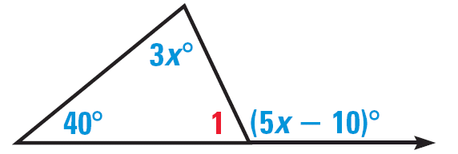
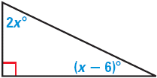
5.1 Angles of Triangles
Find the measure of ∠1 in the diagram.
Find the measures of the acute angles in the diagram.
Notes:
40 + 3x = 5x – 10 → 50 = 2x → x = 25
m∠1 + 40 + 3x = 180 → m∠1 + 40 + 3(25) = 180 → m∠1 + 40 + 75 = 180 → m∠1 = 65
2x + x – 6 = 90 → 3x = 96 → x = 32
Top angle: 2x → 2(32) = 64
Angle at right: x - 6 → 32 - 6 = 26

Slide 12
5.1 Angles of Triangles
228 #2, 4, 6, 10, 12, 14, 16, 18, 20, 22, 24, 26, 28, 32, 42, 44, 48, 55, 58, 59 = 20 total

Slide 13
5.2 Congruent Polygons
After this lesson…
• I can use rigid motions to show that two triangles are congruent.
• I can identify corresponding parts of congruent polygons.
• I can use congruent polygons to solve problems.

Slide 14
5.2 Congruent Polygons
Congruent ≅
Exactly the same shape and size.
Congruent
Not Congruent

Slide 15
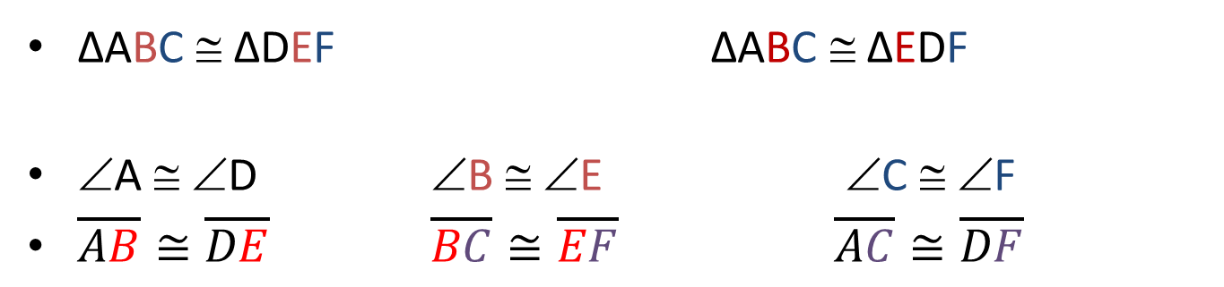
5.2 Congruent Polygons
A
D
C
B
F
E
ΔABC ≅ ΔDEF ΔABC ≅ ΔEDF
∠A ≅ ∠D ∠B ≅ ∠E ∠C ≅ ∠F
$\overline{AB}≅\overline{DE}$ $\overline{BC}≅\overline{EF}$ $\overline{AC}≅\overline{DF}$

Slide 16
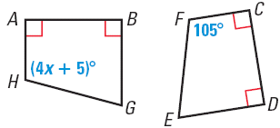
5.2 Congruent Polygons
In the diagram, ABGH ≅ CDEF
  Identify all the pairs of congruent corresponding parts
  Find the value of x and find m∠H.
Notes:
AB ≅ CD, BG ≅ DE, GH ≅ EF, AH ≅ CF
∠A ≅ ∠C, ∠B ≅ ∠D, ∠G ≅ ∠E, ∠H ≅ ∠F
4x + 5 = 105
4x = 100
x = 25
m∠H = 105°

Slide 17
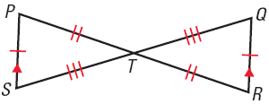
5.2 Congruent Polygons
Show that ΔPTS ≅ ΔRTQ
Notes:
All of the corresponding parts of ΔPTS are congruent to those of ΔRTQ by the indicated markings, the Vertical Angle Theorem and the Alternate Interior Angle theorem.

Slide 18
5.2 Congruent Polygons
Third Angle Theorem
If two angles of one triangle are congruent to two angles of another triangle, then the third angles are congruent.
?
?
75°
20°
75°
20°
Properties of Congruence of Triangles
Congruence of triangles is Reflexive, Symmetric, and Transitive
Notes:
75 + 20 + ? = 180
95 + ? = 180
? = 85

Slide 19
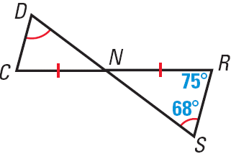
5.2 Congruent Polygons
In the diagram, what is m∠DCN?
By the definition of congruence, what additional information is needed to know that ΔNDC ≅ ΔNSR?
Notes:
m∠DCN = 75°; alt int angle theorem (or 3rd angle theorem)
DN ≅ SN, DC ≅ SR

Slide 20
5.2 Congruent Polygons
235 #2, 3, 4, 6, 8, 10, 12, 13, 14, 15, 17, 18, 20, 21, 24, 26, 28, 30, 31, 32 = 20 total

Slide 21
5.3 Proving Triangle Congruence by SAS
After this lesson…
• I can use the SAS Congruence Theorem.

Slide 22
5.3 Proving Triangle Congruence by SAS
SAS (Side-Angle-Side Congruence Postulate)
If two sides and the included angle of one triangle are congruent to two sides and the included angle of another triangle, then the two triangles are congruent
The angle must be between the sides!!!

Slide 23
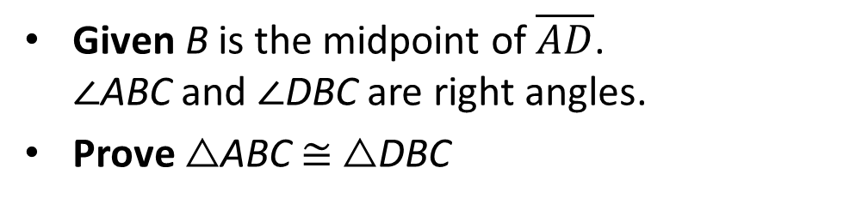
5.3 Proving Triangle Congruence by SAS
Given B is the midpoint of $\overline{AD}$.
∠ABC and ∠DBC are right angles.
Prove △ABC ≅ △DBC
Statements
Reasons
Notes:
B is the midpoint of $\overline{AD}$. $∠ABC$ and $∠DBC$ are right angles (given)
$\overline{AB}≅\overline{BD}$ (definition of midpoint)
$∠ABC≅∠DBC$ (rt. Angles are ≅)
$\overline{BC}≅\overline{BC}$ (reflexive)
△ABC ≅ △DBC (SAS)

Slide 24
5.3 Proving Triangle Congruence by SAS
What can you conclude about △PTS and △RTQ? Explain.
241 #2, 4, 6, 7, 8, 10, 12, 17, 18, 19, 23, 24, 27, 29, 31 = 15 total
Notes:
PT≅TR and ST≅TQ (given)
$∠PTS≅∠RTQ$ (vertical angles are ≅)
△PTS ≅ △RTQ (SAS)

Slide 25
5.4 Equilateral and Isosceles Triangles
After this lesson…
• I can prove and use theorems about isosceles triangles.
• I can prove and use theorems about equilateral triangles.

Slide 26
5.4 Equilateral and Isosceles Triangles
Parts of an Isosceles Triangle
Vertex Angle
Leg
Leg
Base Angles
Base

Slide 27
5.4 Equilateral and Isosceles Triangles
Base Angles Theorem
If two sides of a triangle are congruent, then the angles opposite them are congruent.
Converse of Base Angles Theorem
If two angles of a triangle are congruent, then the two sides opposite them are congruent.

Slide 28
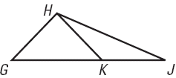
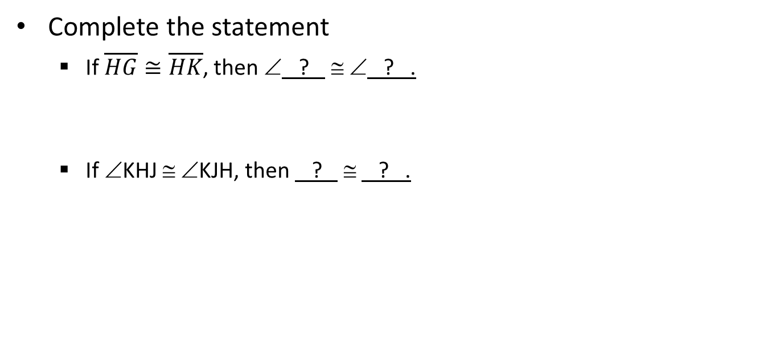
5.4 Equilateral and Isosceles Triangles
Complete the statement
  If $\overline{HG}≅\overline{HK}$, then ∠ ? ≅ ∠ ? .
  If ∠KHJ ≅ ∠KJH, then ? ≅ ? .
Notes:
∠HKG ≅ ∠HGK
KJ ≅ KH

Slide 29
5.4 Equilateral and Isosceles Triangles
Corollary to the Base Angles Theorem
If a triangle is equilateral, then it is equiangular.
Corollary to the Converse of Base Angles Theorem
If a triangle is equiangular, then it is equilateral.

Slide 30
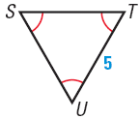
5.4 Equilateral and Isosceles Triangles
Find ST
Find m∠T
Notes:
ST = 5
m∠T = 60° (all angles in equilateral/equiangular triangles are 60°)

Slide 31
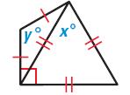
5.4 Equilateral and Isosceles Triangles
Find the values of x and y
248 #2, 4, 6, 8, 12, 14, 16, 18, 20, 21, 22, 24, 27, 28, 30, 36, 38, 39, 40, 43 = 20 total
Notes:
x = 60; equilateral triangle
Each base angle by y; 60 + ? = 90 → ? = 30
Angle sum theorem: 30 + 30 + y = 180 → y = 120

Slide 32
5.5 Proving Triangle Congruence by SSS
After this lesson…
• I can use the SSS Congruence Theorem.
• I can use the Hypotenuse-Leg Congruence Theorem.

Slide 33
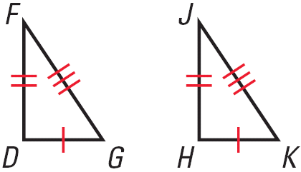
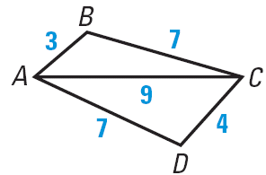
5.5 Proving Triangle Congruence by SSS
SSS (Side-Side-Side Congruence Postulate)
If three sides of one triangle are congruent to three sides of another triangle, then the two triangles are congruent
True or False
  ΔDFG ≅ ΔHJK
  ΔACB ≅ ΔCAD
Notes:
True
False

Slide 34
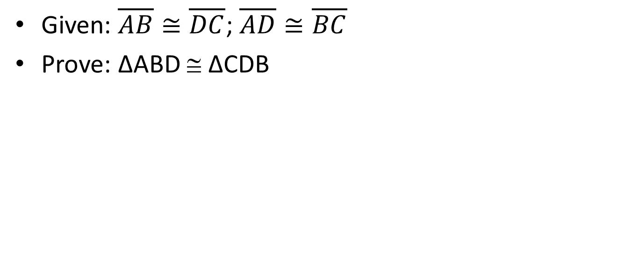
5.5 Proving Triangle Congruence by SSS
Given: $\overline{AB}≅\overline{DC}$; $\overline{AD}≅\overline{BC}$
Prove: ΔABD ≅ ΔCDB
B
A
D
C
Statements
Reasons
Notes:
AB ≅ DC; AD ≅ CB (given)
BD ≅ BD (reflexive)
ΔABD ≅ ΔCDB (SSS)

Slide 35

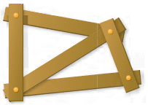
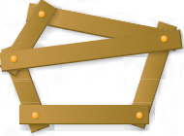
5.5 Proving Triangle Congruence by SSS
Stable structures are made out of triangles
Determine whether the figure is stable.
Notes:
Not stable
Stable since has triangular construction
Not stable, lower section does not have triangular construction

Slide 36
5.5 Proving Triangle Congruence by SSS
Right triangles are special
  If we know two sides are congruent we can use the Pythagorean Theorem (ch 7) to show that the third sides are congruent
Hypotenuse
Leg
Leg

Slide 37
5.5 Proving Triangle Congruence by SSS
HL (Hypotenuse-Leg Congruence Theorem)
If the hypotenuse and a leg of a right triangle are congruent to the hypotenuse and a leg of another right triangle, then the two triangles are congruent

Slide 38
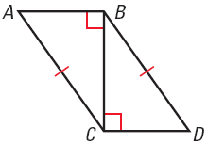

5.5 Proving Triangle Congruence by SSS
Given: ∠ABC and ∠BCD are rt ∠s; $\overline{AC}≅\overline{BD}$
Prove: ΔACB ≅ ΔDBC
Statements
Reasons
Notes:
∠ABC and ∠BCD are rt ∠s; AC ≅ BD (given)
ΔACB and ΔDBC are rt Δ (def rt Δ)
BC ≅ CB (reflexive)
ΔACB ≅ ΔDBC (HL)

Slide 39
5.5 Proving Triangle Congruence by SSS
256 #1, 2, 3, 4, 6, 7, 8, 10, 12, 14, 18, 20, 22, 26, 28, 31, 32, 34, 35, 36 = 20 total

Slide 40
5.6 Proving Triangle Congruence by ASA and AAS
After this lesson…
• I can prove the AAS Congruence Theorem.
• I can use the ASA and AAS Congruence Theorems.

Slide 41
5.6 Proving Triangle Congruence by ASA and AAS
Use a ruler to draw a line of 5 cm.
On one end of the line use a protractor to draw a 30° angle.
On the other end of the line draw a 60° angle.
Extend the other sides of the angles until they meet.
Compare your triangle to your neighbor’s.
This illustrates ASA.
Notes:
Everyone’s triangle should be congruent

Slide 42
5.6 Proving Triangle Congruence by ASA and AAS
ASA (Angle-Side-Angle Congruence Postulate)
If two angles and the included side of one triangle are congruent to two angles and the included side of another triangle, then the two triangles are congruent
The side must be between the angles!

Slide 43
5.6 Proving Triangle Congruence by ASA and AAS
AAS (Angle-Angle-Side Congruence Theorem)
If two angles and a non-included side of one triangle are congruent to two angles and a non-included side of another triangle, then the two triangles are congruent
The side is NOT between the angles!

Slide 44
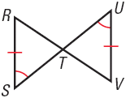
5.6 Proving Triangle Congruence by ASA and AAS
In the diagram, what postulate or theorem can you use to prove that ΔRST ≅ ΔVUT?
Notes:
∠RTS ≅ ∠UTV by Vert. Angles are Congruent
ΔRST ≅ ΔVUT by AAS

Slide 45
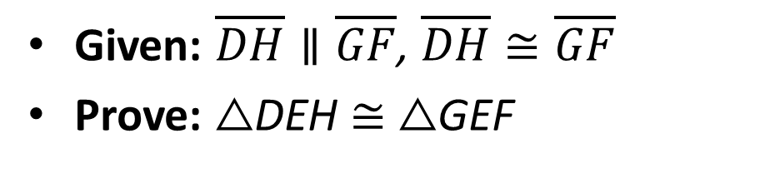
5.6 Proving Triangle Congruence by ASA and AAS
Given: $\overline{DH}∥\overline{GF}$, $\overline{DH}≅\overline{GF}$
Prove: △DEH ≅ △GEF
Statements
Reasons
Notes:
$\overline{DH}∥\overline{GF}$, $\overline{DH}≅\overline{GF}$ (given)
$∠D≅∠G$, $∠H≅∠F$ (alt int angles thrm)
ΔDEH ≅ ΔGEF (ASA)

Slide 46
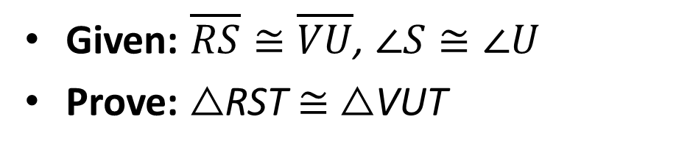
5.6 Proving Triangle Congruence by ASA and AAS
Given: $\overline{RS}≅\overline{VU}$, $∠S≅∠U$
Prove: △RST ≅ △VUT
Statements
Reasons
Notes:
$\overline{RS}≅\overline{VU}$, $∠S≅∠U$ (given)
$∠RTS≅∠VTU$ (vert angles ≅)
ΔRST ≅ ΔVUT (AAS)

Slide 47
5.6 Proving Triangle Congruence by ASA and AAS
264 #2, 4, 6, 8, 12, 14, 16, 22, 24, 28, 35, 38, 39, 40, 41 = 15 total

Slide 48
5.7 Using Congruent Triangles
After this lesson…
• I can use congruent triangles to prove statements.
• I can use congruent triangles to solve real-life problems.
• I can use congruent triangles to prove constructions.

Slide 49
5.7 Using Congruent Triangles
By the definition of congruent triangles, we know that the corresponding parts have to be congruent
CPCTC
Corresponding Parts of Congruent Triangles are Congruent
Your book just calls this “definition of congruent triangles”

Slide 50
5.7 Using Congruent Triangles
To show that parts of triangles are congruent
  First show that the triangles are congruent using
    SSS, SAS, ASA, AAS, HL
  Second say that the corresponding parts are congruent using
    CPCTC or “def ≅ Δ”

Slide 51
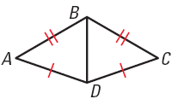
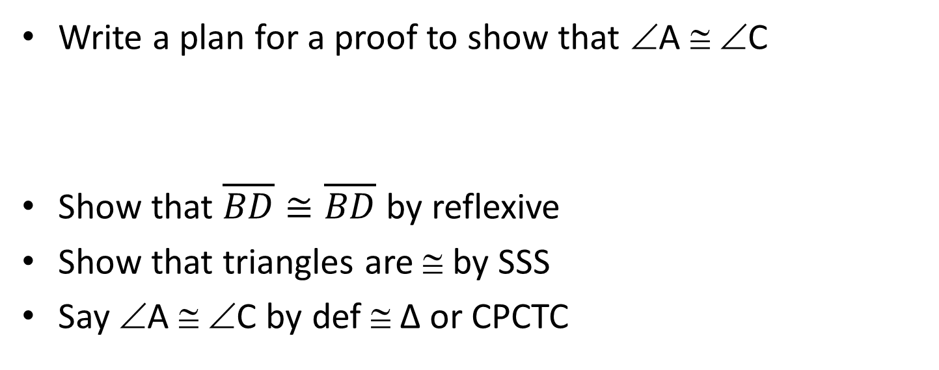
5.7 Using Congruent Triangles
Write a plan for a proof to show that ∠A ≅ ∠C
Show that $\overline{BD}≅\overline{BD}$ by reflexive
Show that triangles are ≅ by SSS
Say ∠A ≅ ∠C by def ≅ Δ or CPCTC

Slide 52
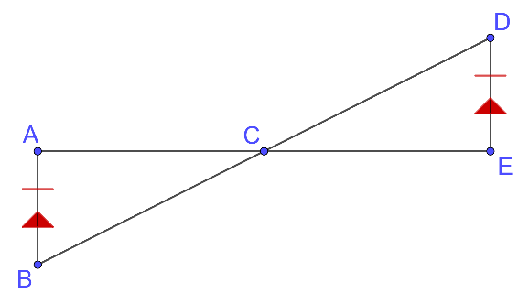

5.7 Using Congruent Triangles
Given: $\overline{AB}≅\overline{DE}$, $\overline{AB}∥\overline{DE}$
Prove: C is the midpoint of $\overline{AE}$
Notes:
$\overline{AB}≅\overline{DE}$, $\overline{AB}∥\overline{DE}$ (given)
∠B ≅ ∠D, ∠A ≅ ∠E (Alt. Int. ∠ Thrm)
ΔABC ≅ ΔEDC (ASA)
$\overline{AC}≅\overline{CE}$ (CPCTC)
C is midpoint of $\overline{AE}$ (Def midpoint)

Slide 53
5.7 Using Congruent Triangles
271 #2, 3, 4, 6, 8, 10, 13, 17, 19, 20, 23, 25, 26, 27, 28 = 15 total

Slide 54
5.8 Coordinate Proofs
After this lesson…
• I can place figures in a coordinate plane.
• I can write plans for coordinate proofs.
• I can write coordinate proofs.

Slide 55
5.8 Coordinate Proofs
Coordinate Proof
Place geometric figures in a coordinate plane (graph)
When variables are used for the coordinates, the result is true for all figures of that type
Use formulas to prove things
  Midpoint formula
  Distance formula
  Slope formula

Slide 56
5.8 Coordinate Proofs
Place figures for Coordinate Proof
Use the origin as a vertex or center.
Place at least one side of the polygon on an axis.
Usually keep the figure within the first quadrant.
Use coordinates that make computations as simple as possible.
You will prove things by calculating things like slope, distance, and midpoints

Slide 57
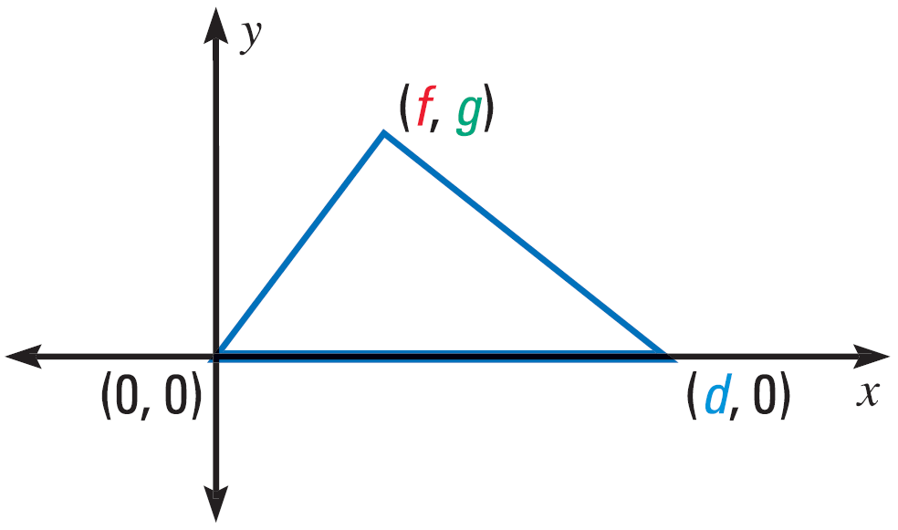
5.8 Coordinate Proofs

Slide 58
5.8 Coordinate Proofs
(0, a)
(a, a)
Place a square in a coordinate plane so that it is convenient for finding side lengths. Assign coordinates.
Place a right triangle in a coordinate plane so that it is convenient for finding side lengths. Assign coordinates.
(0, 0)
(a, 0)
(0, b)
(0, 0)
(a, 0)

Slide 59
5.8 Coordinate Proofs
Place an isosceles triangle in a coordinate plane with vertices P(−2a, 0), Q(0, a), and R(2a, 0). Then find the side lengths and the coordinates of the midpoint of each side.
Notes:
$$PQ=\sqrt{{\left(0−\left(−2a\right)\right)}^{2}+{\left(a−0\right)}^{2}}=\sqrt{4a^{2}+a^{2}}=\sqrt{5a^{2}}=a\sqrt{5};M_{\overline{PQ}}\left(\frac{−2a+0}{2},\frac{0+a}{2}\right)=\left(−a,\frac{a}{2}\right)$$
$$QR=\sqrt{{\left(0−2a\right)}^{2}+{\left(a−0\right)}^{2}}=\sqrt{4a^{2}+a^{2}}=\sqrt{5a^{2}}=a\sqrt{5};M_{\overline{QR}}\left(\frac{2a+0}{2},\frac{0+a}{2}\right)=\left(a,\frac{a}{2}\right)$$
$$PR=\sqrt{{\left(2a−\left(−2a\right)\right)}^{2}+{\left(0−0\right)}^{2}}=\sqrt{16a^{2}}=4a;M_{\overline{PR}}\left(\frac{2a+\left(−2a\right)}{2},\frac{0+0}{2}\right)=\left(0, 0\right)$$

Slide 60
5.8 Coordinate Proofs
Given Coordinates of vertices of quadrilateral OTUV
Prove ∠TOU ≅ ∠VUO
277 #2, 4, 6, 8, 11, 12, 15, 16, 22, 23, 25, 26, 29, 32, 33 = 15 total
Notes:
The slope of $\overline{TO}$ is $\frac{k−0}{m−0}=\frac{k}{m}$.
The slope of $\overline{UV}$ is $\frac{k−0}{(m+h)−h}=\frac{k}{m}$.
Because they have the same slope, $\overline{TO}∥\overline{UV}$.
By the Alternate Interior Angles Theorem, ∠TOU ≅ ∠VUO.

